Slide 1
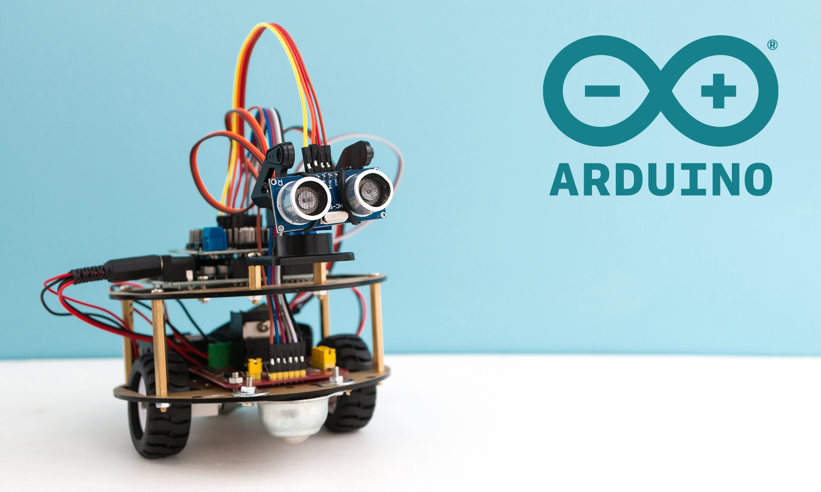
Present by Phyo Aung

Slide 2
What is Arduino?
Arduino is an open-source electronics platform based on easy-to-use hardware and software. Arduino boards are able to read inputs and turn it into an output .
Example – Read inputs such as Light on a sensor, a finger on a button, or a Twitter message and turns it into an output such as turning on a LED, activating a motor, publishing something online

Slide 3
Why Should We Learn Arduino?
Notes:
Arduino ကိုဇာကြောင့်လေ့လာသင့်လဲ?
-Can create amazing projects
[Control RGB Lights, Creating Robots, Automatic System of house(မီးထွန်း၊ကားဂိုဒေါင်တံကား၊ပန်းပင်ရေလောင်း)]
-Easy Programming Language
-Easy to learn Electronics with Arduino
-Arduino is a cheap and useful

Slide 4
Why Should We Learn Arduino?
-Can Create Amazing Projects using Arduino. Example Control
RGB Lights, Creating Robots, Automatic System of house
-Easy Programming Language
-Easy to learn Electronics with Arduino
-Arduino is a cheap and useful

Slide 5
What Type of Programming Language use Arduino?
Arduino uses a variant of the C++ programming language. The code is written in C++ with an addition of special methods and functions. Moreover, when you create a ‘sketch’ (the name given to code files in this language), it is processed and compiled to machine language.
Notes:
A sketch is the name that Arduino uses for a program. It's the unit of code that is uploaded to and run on an Arduino board.

Slide 6
Program Structure Of Arduino
Notes:
Setup function run once
Loop function run repeatedly

Slide 7
Program Structure Of Arduino
Structure
Setup() Function
Setup() Function
Loop() Function
Setup() Function
Loop() Function
Setup() Function
Loop() Function
Variable Declaration
Main Code
Variable Declaration
Main Code
Variable Declaration
Notes:
Setup function run once
Loop function run repeatedly

Slide 8
Different Types of Arduino Boards:
Arduino UNO
Arduino NANO
Arduino Leonard
Arduino Micro

Slide 9
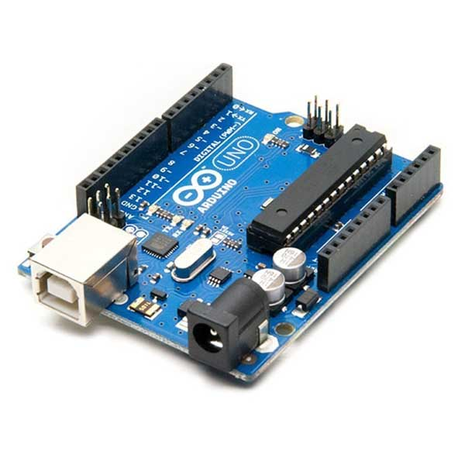
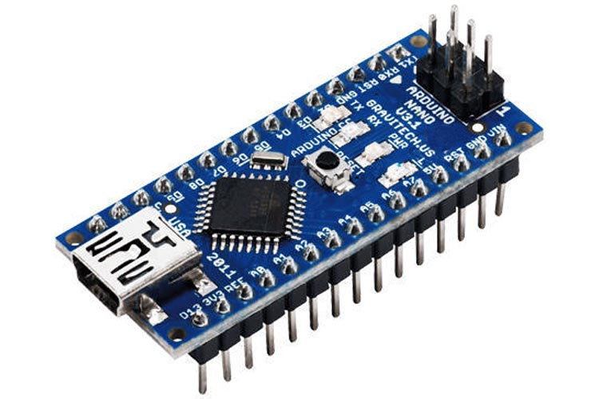
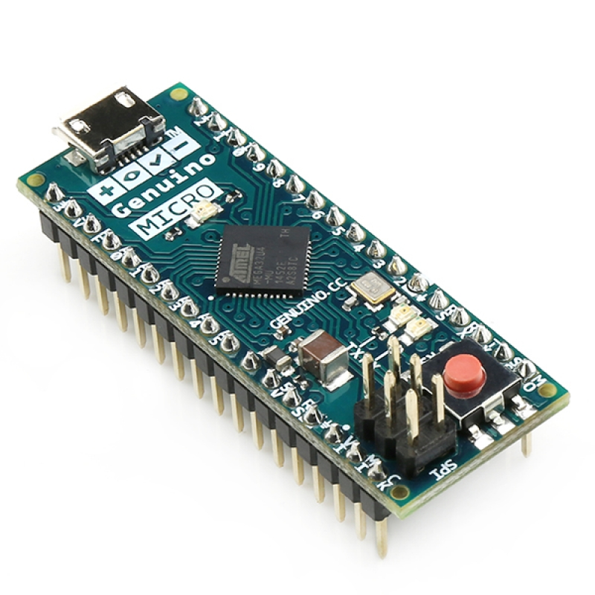
Arduino NANO Board
Arduino UNO Board
Arduino Micro Board
Arduino Leonard Board

Slide 10
Types Of Arduino Sensors
Light sensor
Motion sensor
Temperature sensor
Magnetic fields sensor
Gravity sensor
Humidity sensor
Moisture sensor
Vibration sensor
Pressure sensor
Electrical fields sensor
Sound sensor
Position sensor

Slide 11
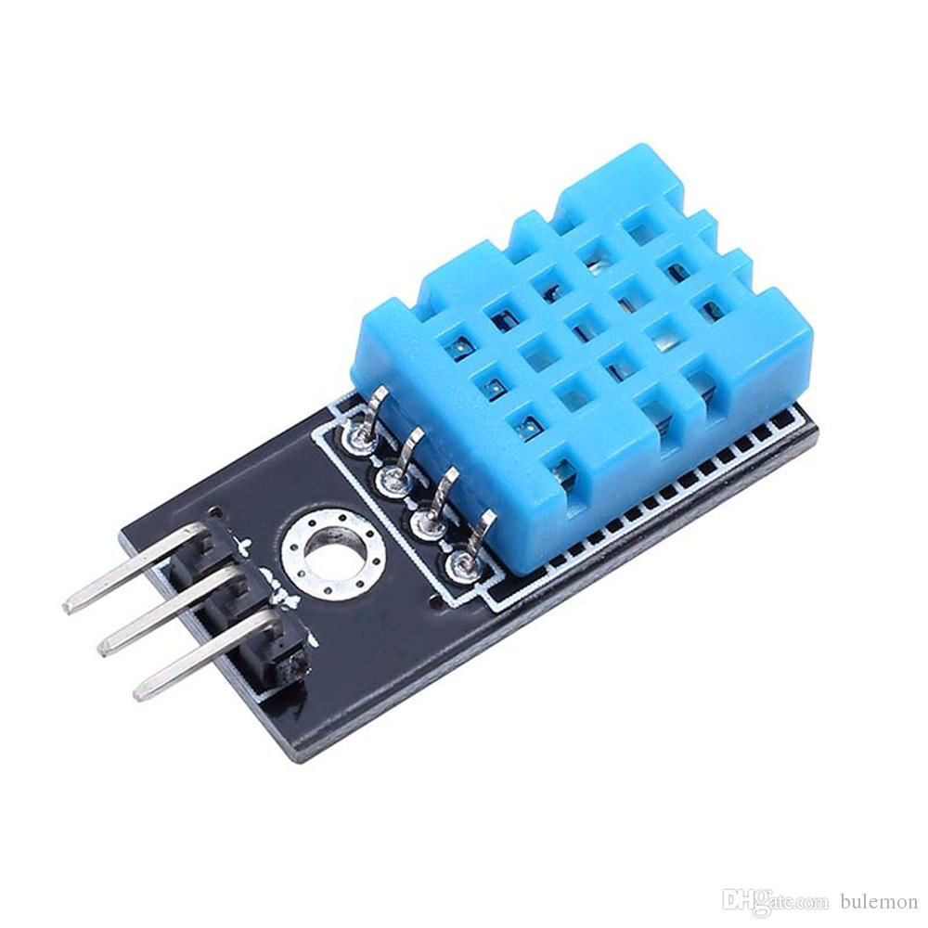
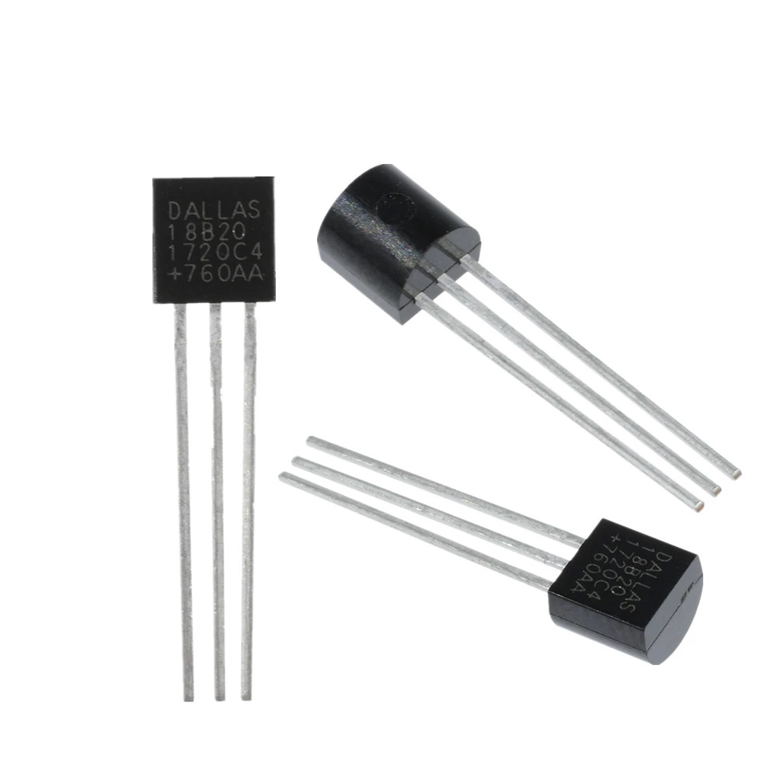
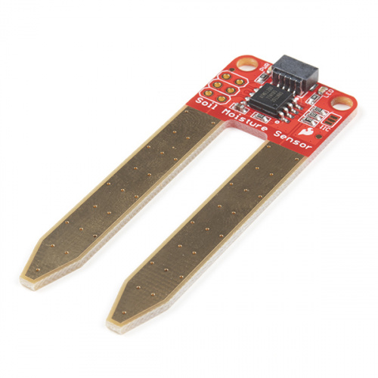
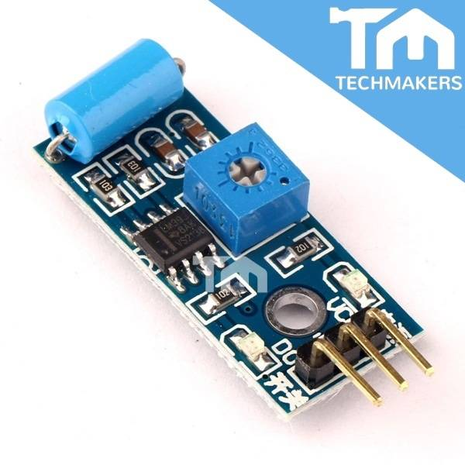
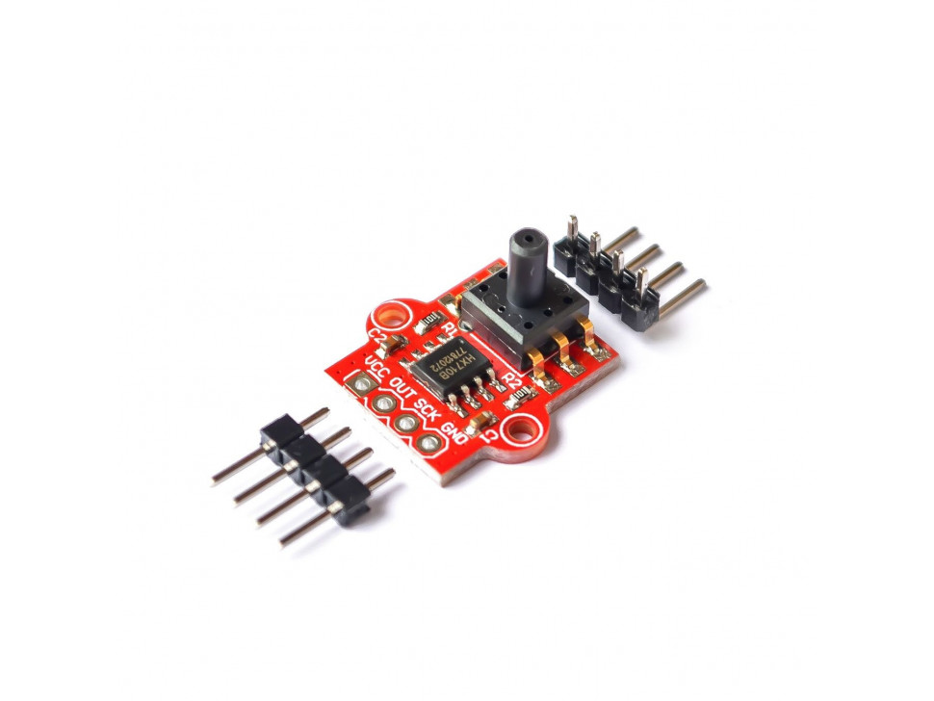
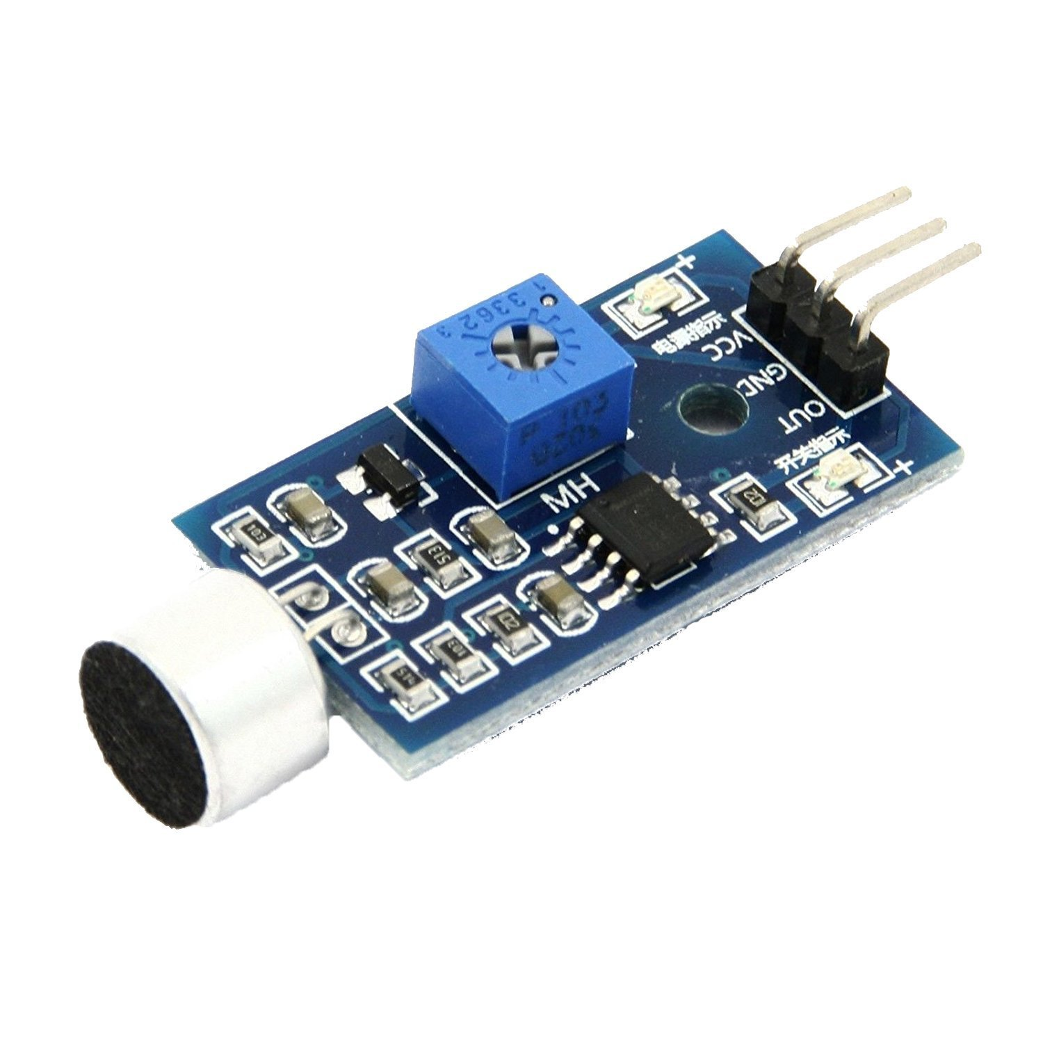
Magnetic Field Sensor
Motion Sensor
Light Sensor (Photoresistor)
Humidity Sensor
Gravity Sensor
Temperature Sensor
Vibration Sensor
Moisture Sensor
Sound Sensor
Pressure Sensor

Slide 12
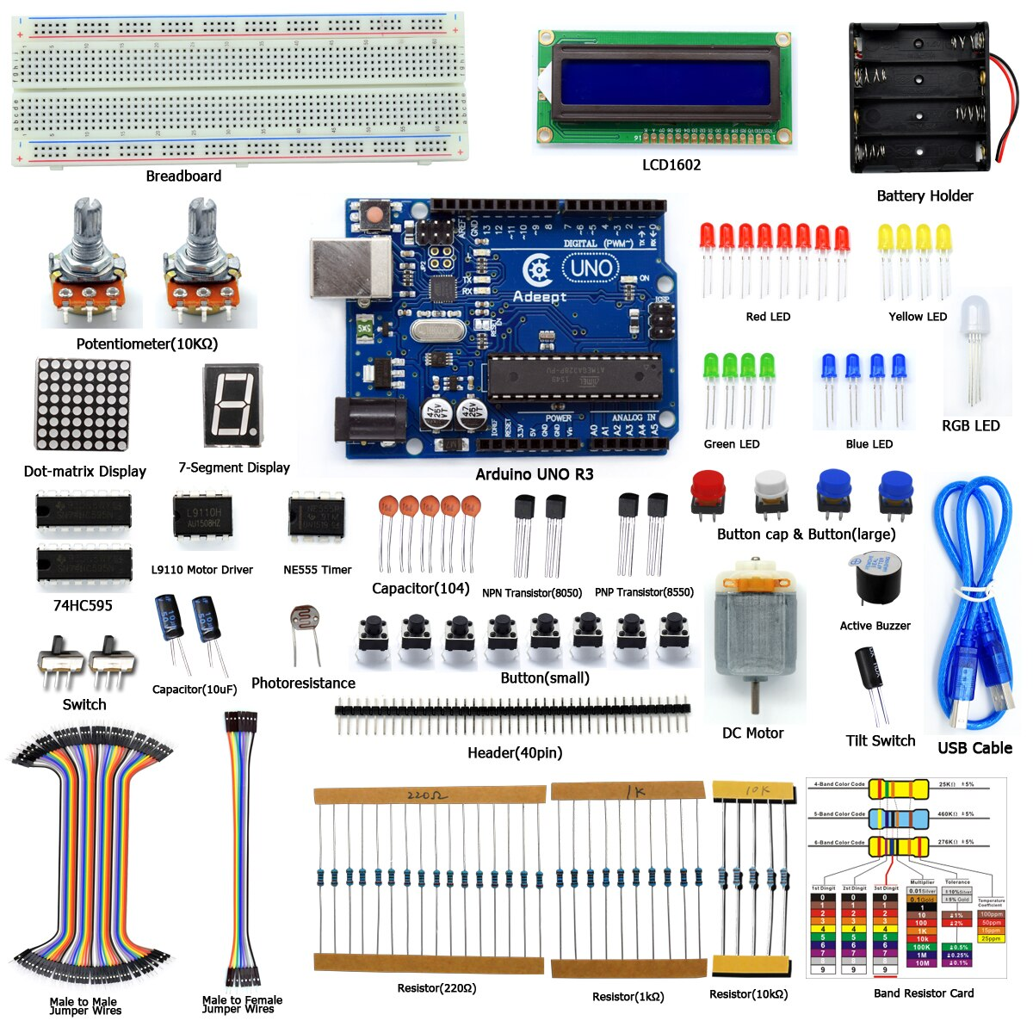
Basic Requirements For
Arduino Project
Notes:
Arduino UNO Starter kit

Slide 13



Slide 14



